Slide 1
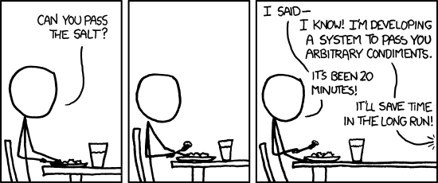
Functions
Make meaningful parts of your code reusable
https://xkcd.com/974/

Slide 2
Topics
Introduction: GUI and basic calculations
Coding 1: Scripts, style, and variable classes
Coding 2: Control statements and loops
Visualization 1: Basics, subplots, get and set
Coding 3: Functions
Visualization 2: Descriptive plots
Coding 4: Basic input and output
Visualization 3: Distribution and 3D plots
Coding 5: Input and output specials – last lecture before holidays
Machine Learning 1: Introduction and dimension reduction
Machine Learning 2: Clustering
Machine Learning 3: Classification
Coding 6: Efficiency and debugging basics
Coding 7: Advanced functions and debugging

Slide 3
Excursion: Good coding practices
Hard vs soft coding
Hard coding: have parameters set somewhere inside your script
Tempting, if you‘re in a hurry, but painful to debug
Soft coding: set parameters as variables in the beginning of your script
Never overwrite your parameters somewhere inside your script
NEVER overwrite your parameters inside your script
Seriously.
DRY: Don‘t Repeat Yourself („Copy & Waste“)
If you copy code without meaningful modification, you‘re making a mistake.
Wrap it in a function
Test your software or your users will. Assume the DAU.
Don‘t run scripts that assume variables in the workspace. Use functions!
No broken windows, don‘t get boiled like a frog.

Slide 4
Functions
Scripts that take input and give output
Have their own workspace, can not access outside variables
Global variables are possible but in most cases evil.
Own functions should have the same filename as their function name
Syntax: function outputs = function_name(inputs)
Noteworthy examples:
length, size, numel, find, max, min, abs, sqrt, rand, randn, randi, sum, prod, linspace, mean, nanmean, var, nanvar, std, num2str, str2num, cell2mat, mat2cell, deal, regexp

Slide 5
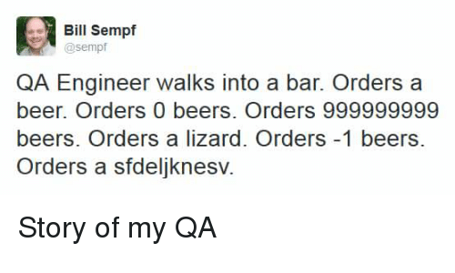
Writing a function
Check which for function and variable names before!
"edit", "help", "doc", "lookfor"
Help description first:
copied function line, outline of function, inputs, outputs, examples, author (don't use email address because of potential spambots, use website if you must), potentially license
Code:
input checks
computation
output
Spacing, new lines, and indentation (CTRL-I).
"..." can be used to create linebreaks without MATLAB treating them as such

Slide 6
The MATLAB Path
Tell MATLAB where to look for files and scripts
Everything you want to use has to be in the path
Current folder counts
Current folder navigation/modifications: cd, pwd, dir, mkdir, rmdir
Modify the path at “Home -> Set Path -> Add Folder”
Counts for all users, so be careful!
Addpath, genpath -> only for one session, gone when you close MATLAB
Safest: Create a startup.m file in the “userpath” that gets executed whenever you start MATLAB

